Slide 1
Class Diagram – Product, Inventory
Madhuri Vemulapaty

Slide 2
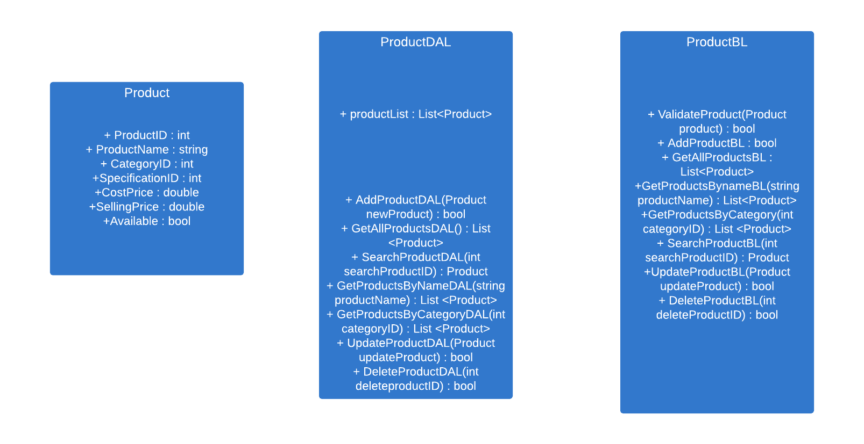

Slide 3
